Slide 1
1- Fundamental of GANs
Risman Adnan Mattotorang
Software R&D Director
Samsung R&D Institute Indonesia

Slide 2
Welcome to Data Science Center UI
What You Will Learn Today
Introduction to Generative Models
Overview Generative Adversarial Networks
Deep Convolutional GAN
Conditional GAN
What You Will Practice Today
Setup Your GAN experiment (Collab, PyTorch)
Create Your First GAN
DCGAN Model
Conditional GAN Model

Slide 3
Outline
Introduction to Generative Models
Generative Adversarial Networks (GANs)
Improved GAN Techniques
Deep Convolutional GAN (DCGAN)
Conditional GAN (CGAN)

Slide 4
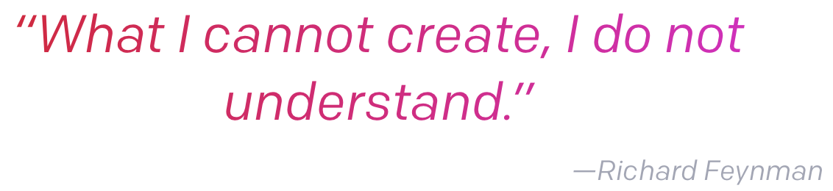
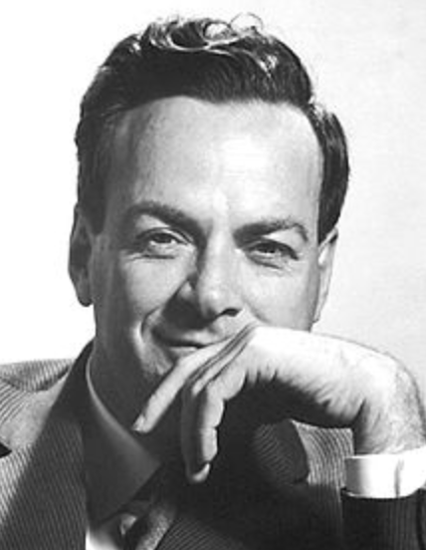
Generative vs Discriminative Model
Discriminative Model
Learn hypothesis function that map input data (x) to some desired output class label (y). In probabilistic terms, learn the conditional distribution P(y|x).
Generative Model
Learn the joint probability of the input data (x) and labels simultaneously, i.e. P(x,y). This can be converted to P(y|x) for classification via Bayes rule.
Generative model can learn to create new sample data (x,y).

Slide 5
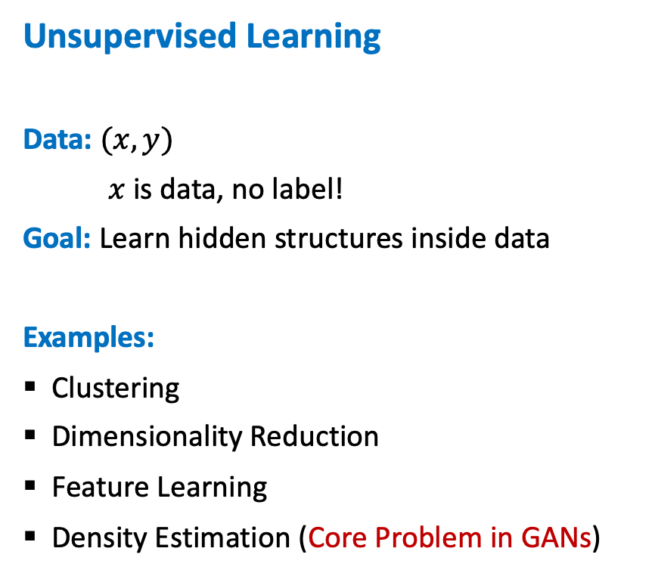
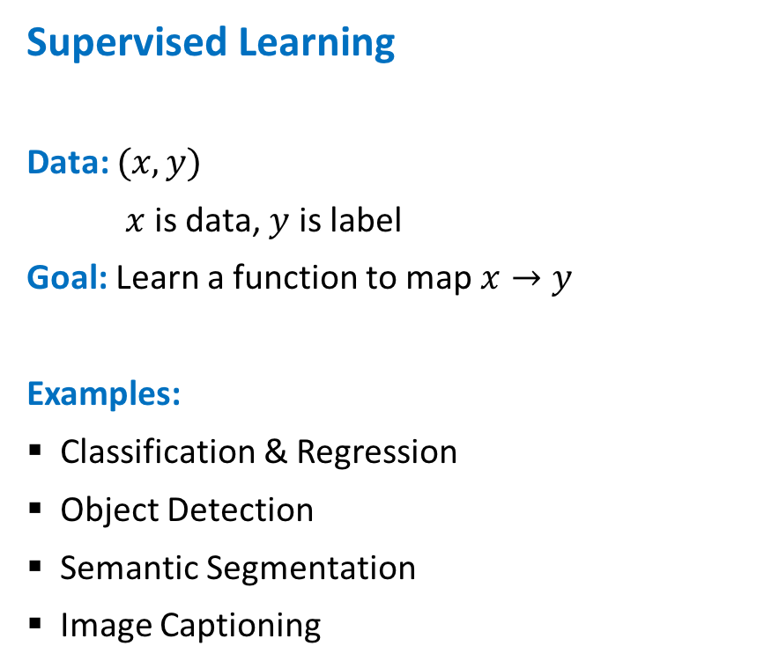
Supervised vs Unsupervised Learning
Supervised Learning
Data: $(x,y)$
$x$ is data, $y$ is label
Goal: Learn a function to map $x→y$
Examples:
Classification & Regression
Object Detection
Semantic Segmentation
Image Captioning
Unsupervised Learning
Data: $(x,y)$
$x$ is data, no label!
Goal: Learn hidden structures inside data
Examples:
Clustering
Dimensionality Reduction
Feature Learning
Density Estimation (Core Problem in GANs)

Slide 6
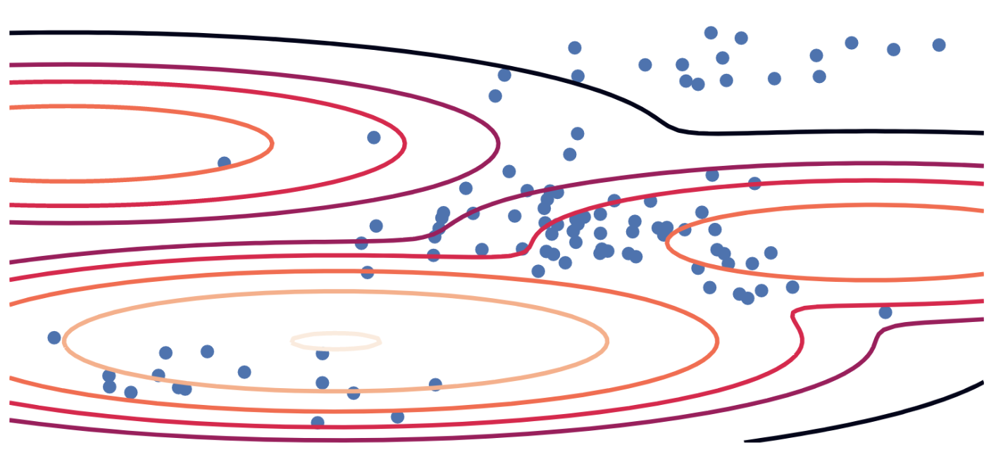
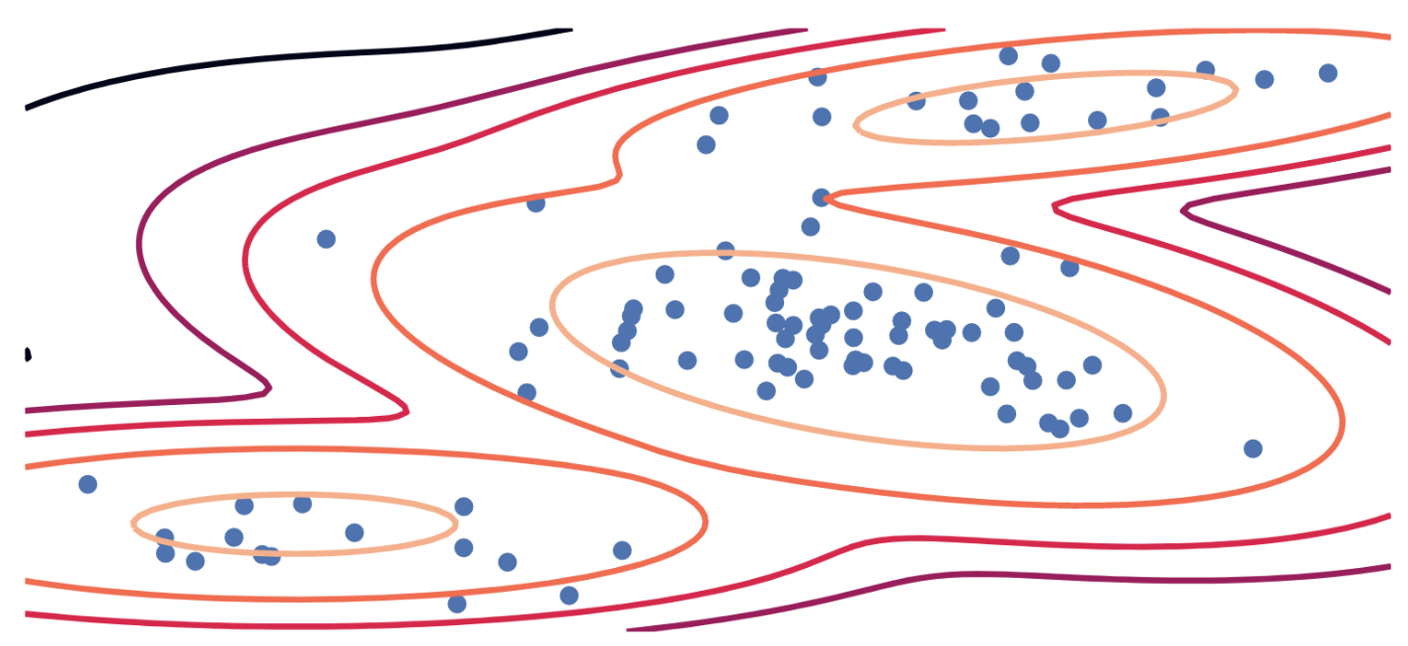
Generative Models: A Traditional Explicit Way
Fit Model
Training Data:
Given $\left\{x\right\}\sim p$ (known$X$, unknown $p$)
Maximum Likelihood (MLE):
$$\max_{θ} 𝔼_{X\sim P}[log q_{θ}(X)]$$
Parametric Model:
Distribution $q_{θ}(x)$ (known $q$, unknown $θ$)
Equivalent to KL Divergence:
$$\min_{θ} KL\left(P∥Q_{θ}\right)=\min_{θ}\int{p\left(x\right)\log{\frac{p(x)}{q_{θ}(x)}dx}}$$

Slide 7
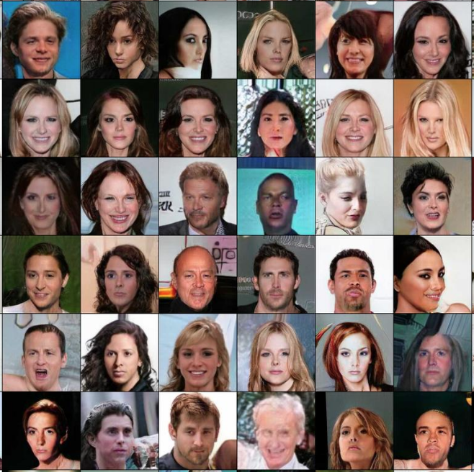
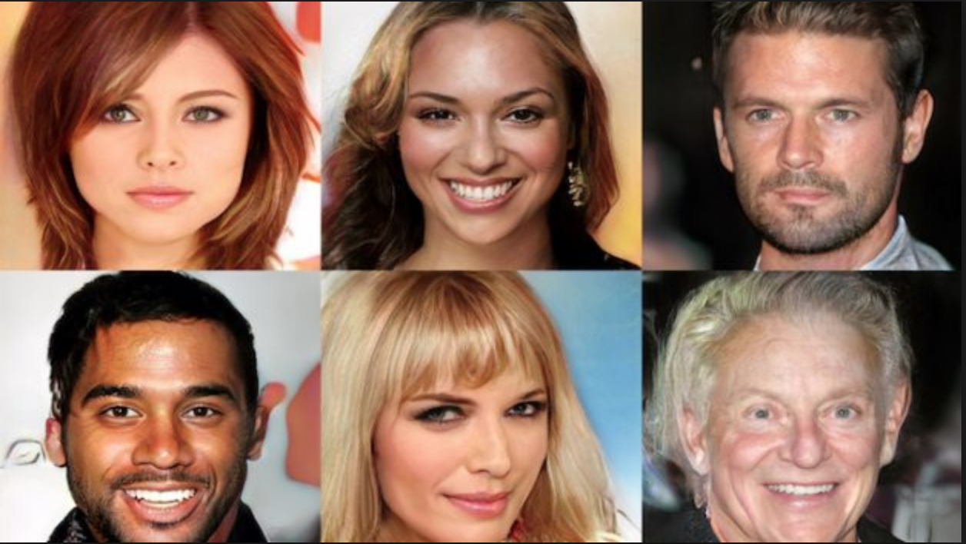
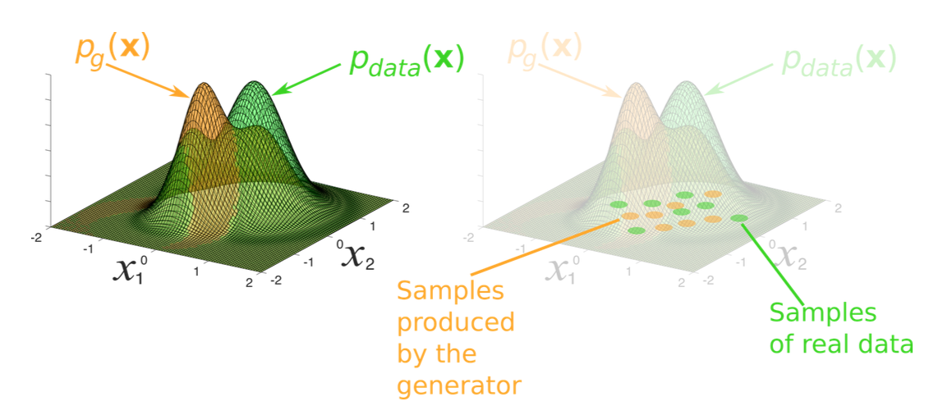
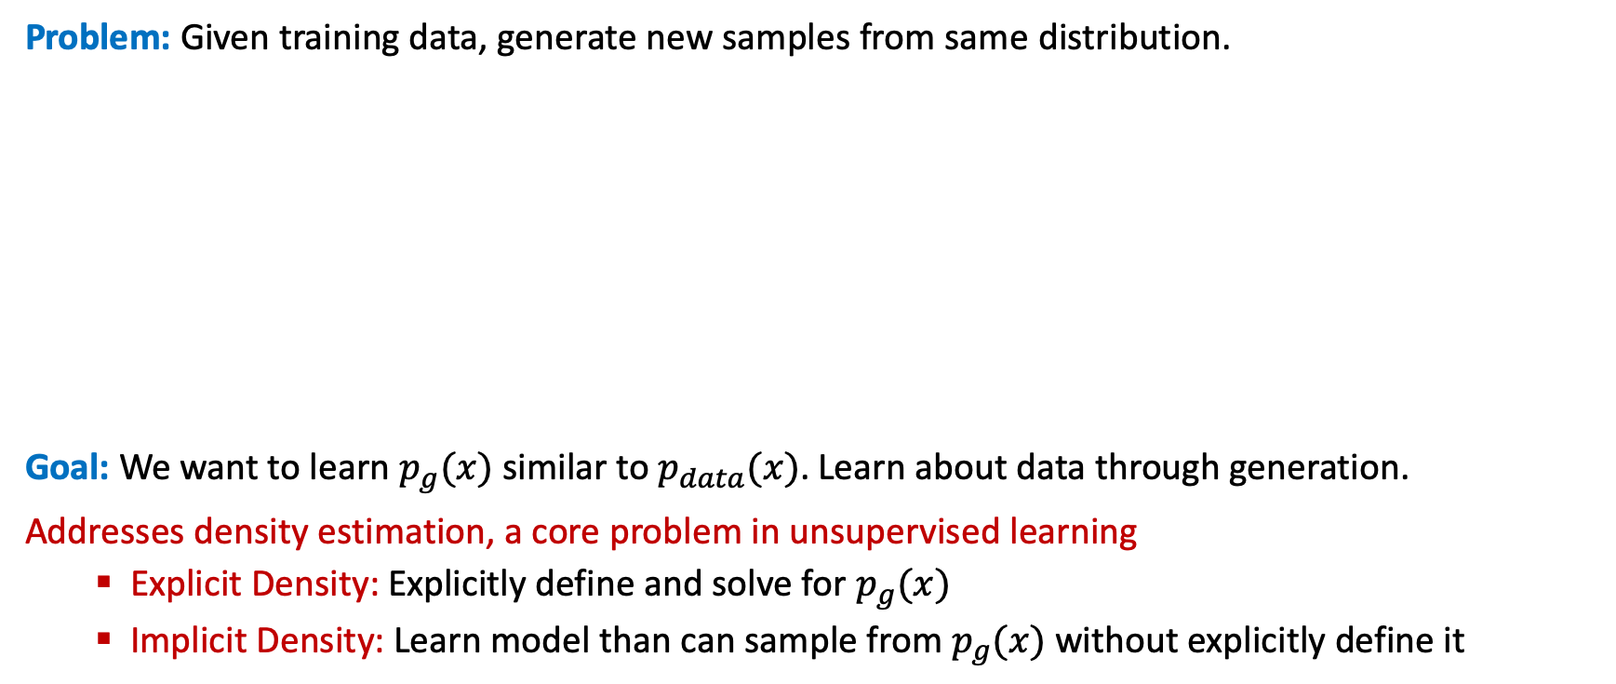
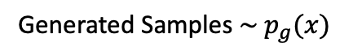
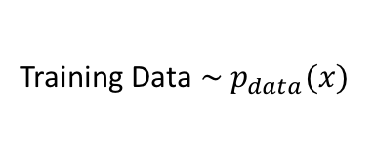
Generative Models
Problem: Given training data, generate new samples from same distribution.
Goal: We want to learn $p_{g}(x)$ similar to $p_{data}(x)$. Learn about data through generation.
Addresses density estimation, a core problem in unsupervised learning
Explicit Density: Explicitly define and solve for $p_{g}(x)$
Implicit Density: Learn model than can sample from $p_{g}(x)$ without explicitly define it
Training Data $\sim p_{data}(x)$
Generated Samples $\sim p_{g}(x)$

Slide 8
Why Generative Models Important?
Advantages of Generative Models:
Represent and manipulate high-dimensional probability distribution
Can be incorporated into (inverse) reinforcement learning in several ways
Can be trained with missing data on semi-supervised learning
Can provide predictions on inputs that are missing data
Enable machine learning to work with multi-modal outputs
Many tasks intrinsically require realistic generation of samples from some distributions:
Creating Art and Realistic Images
Single Image Super-Resolution
Image-To-Image Translation
What I cannot create, I do not understand!
-- Richard Feynman

Slide 9
Applications of Generative Models
Computer Vision | Speech Recognition | Natural Language
Realistic Image Creation | Generative Speech Enhancement | Realistic Text Generation
Image-to-Image Translation | Speech Driven Animation | Text Translation
Synthetic Image Creation | Lips Talking and Reading | Text Corpora Generation
Image and Shape In-Painting | Synthetic Audio/Voice | Generative Machine Translation
Object/Image Reconstruction | Voice Conversion | Conditional Sequence Generation
Image Super-Resolution | Voice Separation | Neural Dialog Generation
Face Emotion and Aging | Voice Impersonation | Generative Conversation Responses
Video Frame Prediction | Speech and Speaker Emotion | Text Style Transfer
Video Deblurring | Postfilter for Synthesized speech | Abstractive Summarization
Many More …. | Many More …. | Many More ….
Source: The GAN Zoo and Really Awesome GAN

Slide 10
Taxonomy of Generative Models
Generative Models
Direct
Maximum Likelihood
Generative Adversarial Nets
Explicit Density
Implicit Density
Tractable Density
Approximate Density
Markov Chain
Fully Viable Belief Nets
NADE
MADE
PixelRNN/CNN
Change of Variable
Models (Nonlinear ICA)
Variational
Markov Chain
GSN
Variational Autoencoder
Boltzmann Machine
NIPS 2016 Tutorial: Generative Adversarial Networks
Notes:
Not every generative model uses maximum likelihood. Some generative models do not use maximum likelihood by default, but can be made to do so (GANs fall into this category). By ignoring those models that do not use maximum likelihood, and by focusing on the maximum likelihood version of models that do not usually use maximum likelihood, we can eliminate some of the more distracting differences between models.
The basic idea of maximum likelihood is to define a model that provides an estimate of a probability distribution, parameterized by parameters . We then refer to the likelihood as the probability that the model assigns to the training data for a dataset containing finite training examples.
The principle of maximum likelihood simply says to choose the parameters for the model that maximize the likelihood of the training data. This is easiest to do in log space, where we have a sum rather than a product over examples.
We can also think of maximum likelihood estimation as minimizing the KL divergence between the data generating distribution and the model. Minimizing the KL divergence between pdata and pmodel is exactly equivalent to maximizing the log-likelihood of the training set.

Slide 11
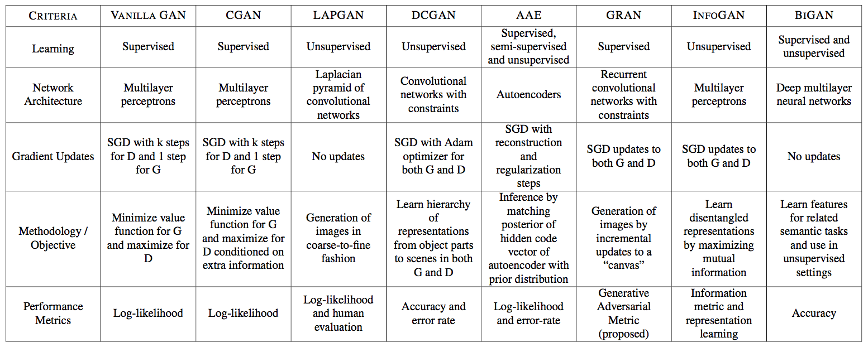
Variety of GAN Models

Slide 12
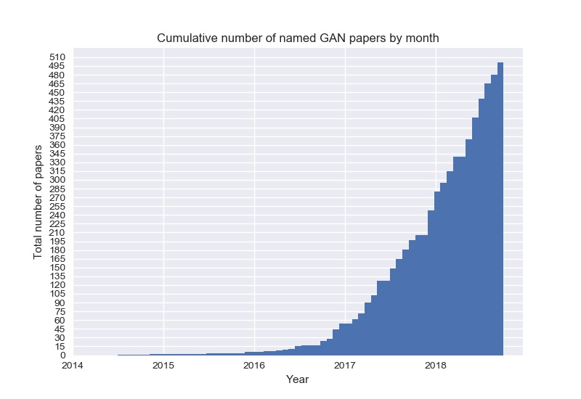
The GAN Zoo
GAN
ACGAN
BGAN
CGAN
DCGAN
EBGAN
fGAN
GoGAN
……
$$α β γ$$

Slide 13
Outline
Introduction to Generative Models
Generative Adversarial Networks (GANs)
Improved GAN Techniques
Deep Convolutional GAN (DCGAN)
Conditional GAN (CGAN)

Slide 14
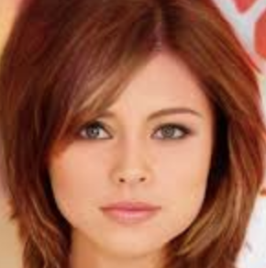
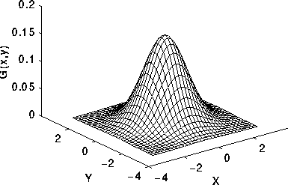
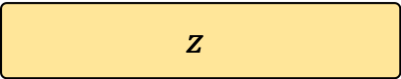
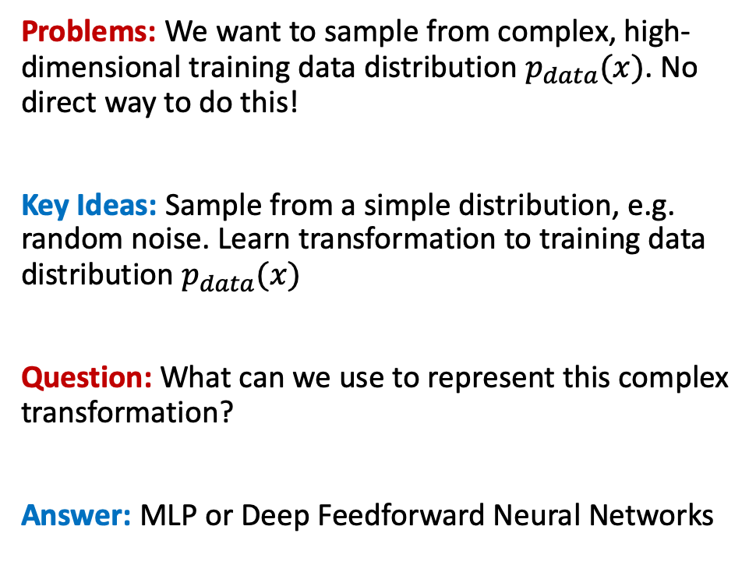
Generative Adversarial Networks
Problems: We want to sample from complex, high-dimensional training data distribution $p_{data}(x)$. No direct way to do this!
Key Ideas: Sample from a simple distribution, e.g. random noise. Learn transformation to training data distribution $p_{data}(x)$
Question: What can we use to represent this complex transformation?
Answer: MLP or Deep Feedforward Neural Networks
Output: Generated sample
from training distribution
Generator
(Neural Network)
p(z)
Input: Random Noise
$$z$$

Slide 15
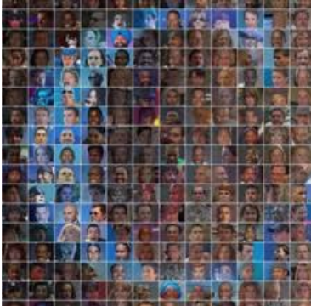
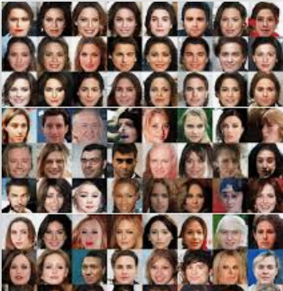
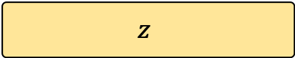
Generative Adversarial Networks
Output: Scalar
[Synthetic (0), Real (1)]
Problems: How to train generator network?
Key Ideas: Compete two NNs in two-player minimax game
Generator Network (G)
Tries to mimic example from training dataset, which sampled from “unknown” true data distribution. It takes noise z as input and generate synthetic samples.
Discriminator Network (D)
Receive samples from both G and training data (but it is not told where the sample comes from) and predict whether it is a data sample or synthetic.
D trained to make accurate predictions, and G is trained to output samples that fool the discriminator.
Discriminator Network (D)
Synthetic Faces
(generated)
Input: Real Images
(CelebA dataset)
Generator Network (G)
Input: Random Noise
$$z$$
Notes:
The basic idea of GANs is to set up a game between two players. One of them is called the generator. The generator creates samples that are intended to come from the same distribution as the training data. The other player is the discriminator. The discriminator examines samples to determine whether they are real or fake.
The two players in the game are represented by two functions, each of which is differentiable both with respect to its inputs and with respect to its parameters. Both players have cost functions that are defined in terms of both players’ parameters in adversarial setting.
Because each player’s cost depends on the other player’s parameters, but each player cannot control the other player’s parameters, this scenario is most straightforward to describe as a game rather than as an optimization problem. The solution to an optimization problem is a (local) minimum, a point in parameter space where all neighboring points have greater or equal cost. The solution to a game is a Nash equilibrium.
The generator The generator is simply a differentiable function G. When z is sampled from some simple prior distribution, G(z) yields a sample of x drawn from pmodel. Typically, a deep neural network is used to represent G.
The GAN framework pits two adversaries against each other in a game. Each player is represented by a differentiable function controlled by a set of parameters. Typically these functions are implemented as deep neural networks.

Slide 16
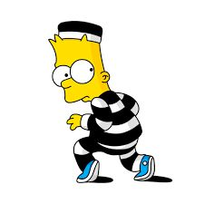

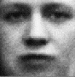



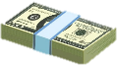
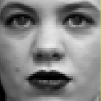

GAN Analogy: Counterfeit vs Police Game
Discriminative Model D
Generative Model G
IT’S FAKE MONEY!
…
…
…
…
IT’S REAL MONEY!
…
…
p(z)
…
…
Sample x
Random noise z
Source: NIPS 2016 Tutorial on GAN

Slide 17
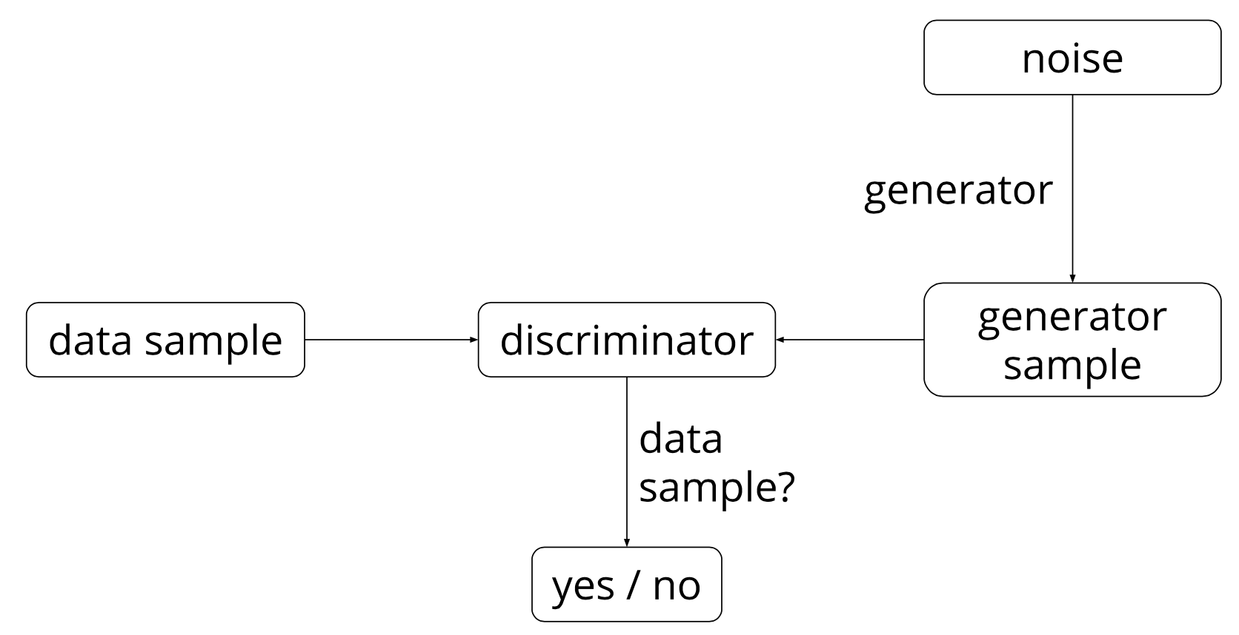
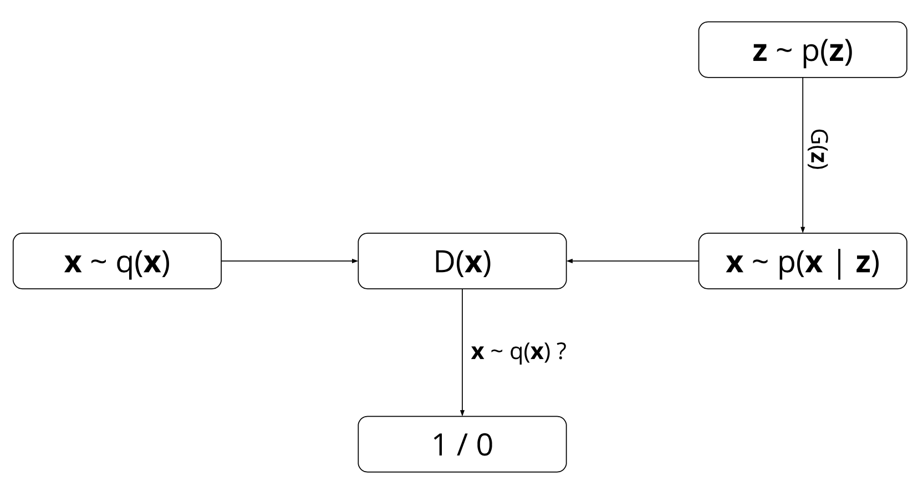
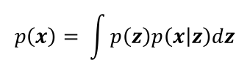
GAN Probabilistic View
GAN Models
Two marginal distributions are defined:
q(x) : the data marginal distribution (unknown)
p(x) : the model marginal distribution,
GAN operates as following:
G: sampling z ~ p(z) then sampling x ~ p(x|z)
D: receive x ~ q(x), outputs prediction
D outputs likelihood in (0,1) of real image q(x)
Learnable minimax objective function of D and G is:
Probabilistic View
Discriminator output for real data x
$$p\left(x\right)= \int{p\left(z\right)p\left(x | z\right)dz}$$
Discriminator output for fake data G(z)

Slide 18
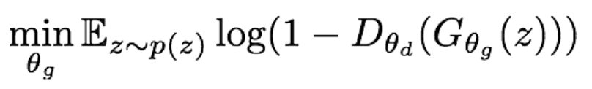
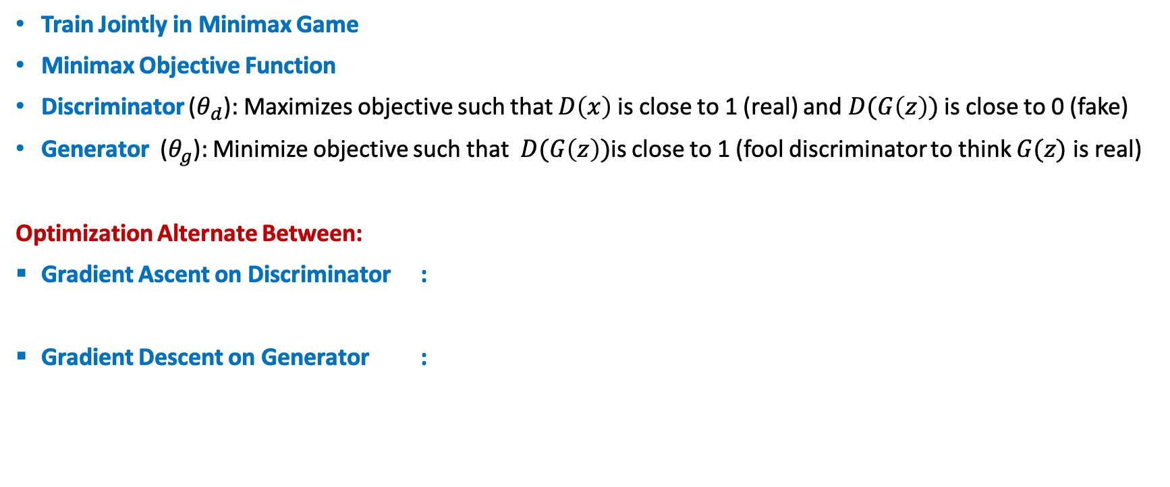
Training Minimax GANs: Two-Player Game
Train Jointly in Minimax Game
Minimax Objective Function
Discriminator ($θ_{d}$): Maximizes objective such that $D\left(x\right)$ is close to 1 (real) and $D(G\left(z\right))$ is close to 0 (fake)
Generator ($θ_{g}$): Minimize objective such that $D(G\left(z\right))$is close to 1 (fool discriminator to think $G(z)$ is real)
Optimization Alternate Between:
Gradient Ascent on Discriminator :
Gradient Descent on Generator :
Notes: Jointly training two networks is challenging, can be unstable.
Choosing objectives with better loss landscapes helps training, is an active area of research.
Notes:
The game plays out in two scenarios. In one scenario, training examples x are randomly sampled from the training set and used as input for the first player, the discriminator, represented by the function D. The goal of the discriminator is to output the probability that its input is real rather than fake, under the assumption that half of the inputs it is ever shown are real and half are fake. In this first scenario, the goal of the discriminator is for D(x) to be near 1. In the second scenario, inputs z to the generator are randomly sampled from the model’s prior over the latent variables. The discriminator then receives input G(z), a fake sample created by the generator. In this scenario, both players participate. The discriminator strives to make D(G(z)) approach 0 while the generative strives to make the same quantity approach 1. If both models have sufficient capacity, then the Nash equilibrium of this game corresponds to the G(z) being drawn from the same distribution as the training data, and D(x) = 1/2 for all x.
The training process consists of simultaneous SGD. On each step, two minibatches are sampled: a minibatch of x values from the dataset and a minibatch of z values drawn from the model’s prior over latent variables. Then two gradient steps are made simultaneously. In both cases, it is possible to use the gradient-based optimization algorithm of your choice. Adam (Kingma and Ba, 2014) is usually a good choice. Many authors recommend running more steps of one player than the other, but as of late 2016, the author’s opinion is that the protocol that works the best in practice is simultaneous gradient descent, with one step for each player.

Slide 19
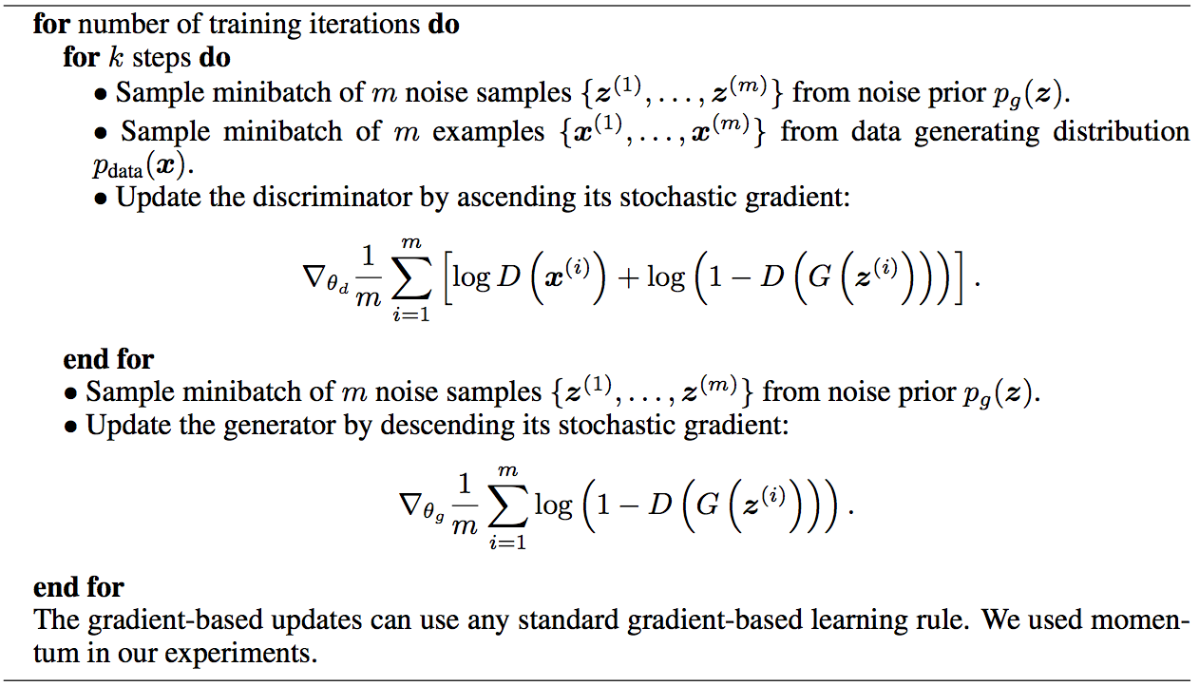
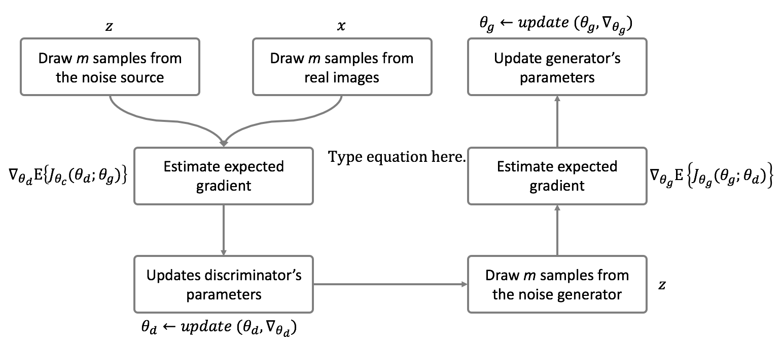
Training MM-GANs: Algorithm
Some find k=1 more stable, others use k > 1, no best rule.
Recent work (e.g. Wasserstein GAN) alleviates this problem, better stability!

Slide 20
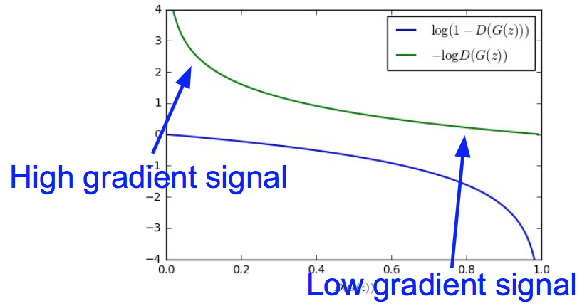
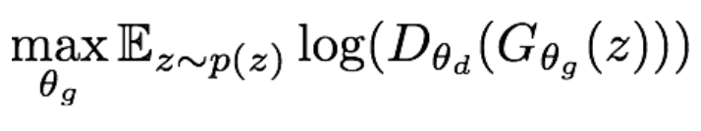
Non-Saturating GANs: NS-GAN Optimization
Optimizing the generator objective does not work well!
Gradient signal dominated by region where sample is already good
When sample is likely fake, want to learn from it to improve generator. But gradient in this region is relatively flat!
Instead of minimizing likelihood of discriminator being correct, now maximize likelihood of discriminator being wrong.
Standard in practice: Same objective of fooling discriminator, but now higher gradient signal for bad samples => works much better!
Gradient Ascent on Generator with Different Objective:

Slide 21
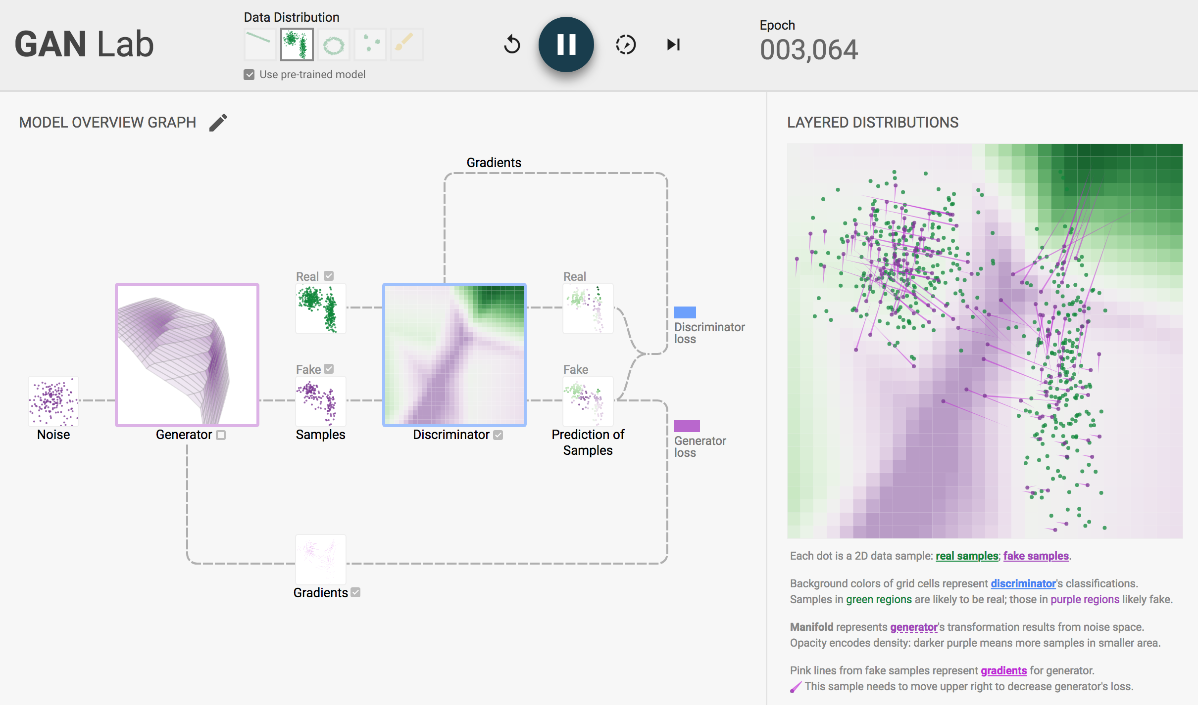
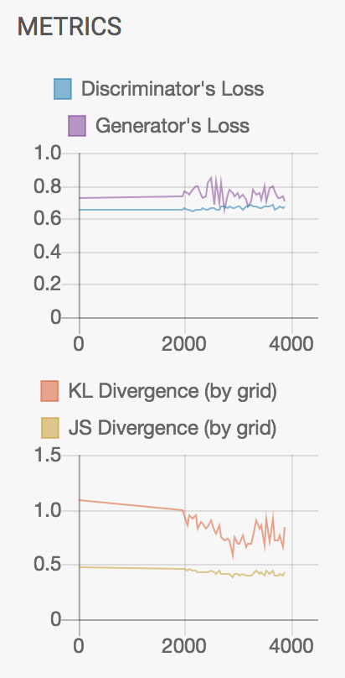
GAN Lab Animation
Source: https://poloclub.github.io/ganlab/

Slide 22
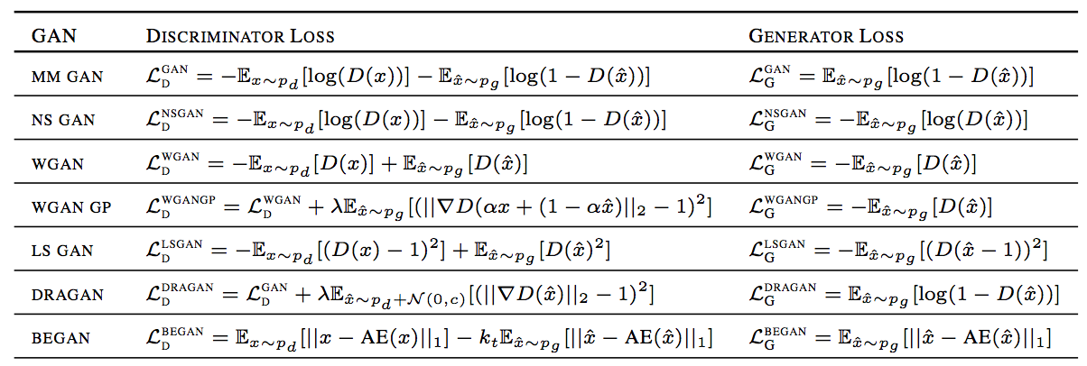
Variety of GAN Objectives
Note: We will use variant of WGAN models in many cases

Slide 23
Outline
Introduction to Generative Models
Generative Adversarial Networks (GANs)
Improved GAN Techniques
Deep Convolutional GAN (DCGAN)
Conditional GAN (CGAN)

Slide 24
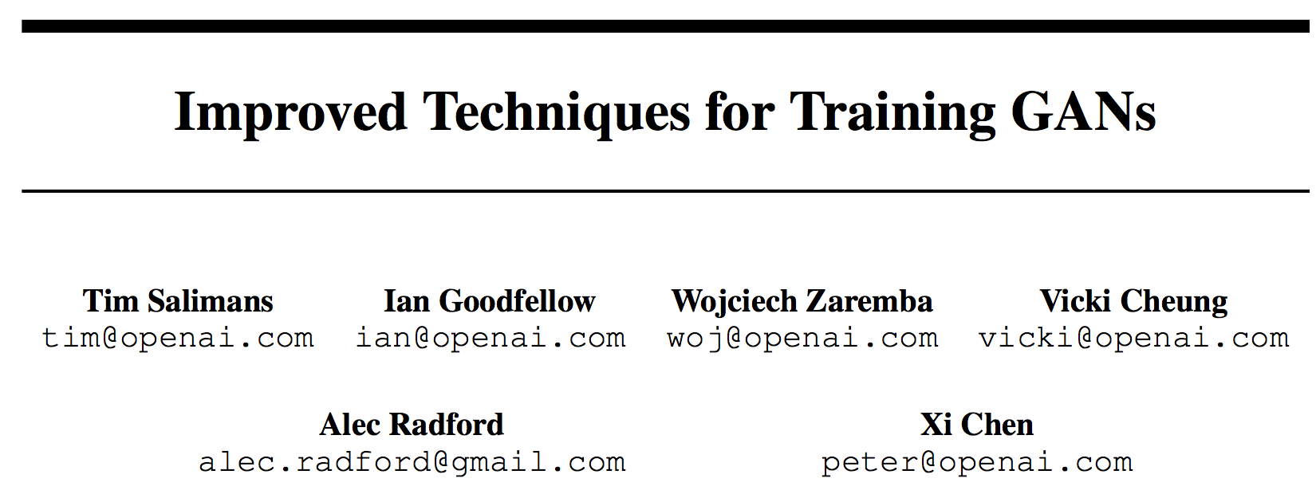
Problems in Training GANs
Training GANs requires finding Nash equilibrium of a non-convex game with continuous, high dimensional parameters.
Gradient descent techniques are designed to find low value of cost function, rather than to find the Nash equilibrium of a game.
When used to seek Nash equilibrium Gradient descent may fail to converge.
Saliman, et.al, @ NIPS 2016
Several heuristic techniques to encourage convergence of GAN game. All codes and hyperparameters available at Github.

Slide 25
Improved GAN Techniques
Training GANs consists in finding a Nash equilibrium to a two-player non-cooperative game. A Nash equilibrium is a point such that cost functions of D and G are both at minimum. Finding Nash equilibria is a very difficult problem. Algorithms exist for specialized cases, but hard to apply to the GAN game, where the cost functions are non-convex, the parameters are continuous, and the parameter space is extremely high-dimensional.
Common Heuristic Techniques Described in The Paper :
Feature Matching
Minibatch Discrimination
Historical Averaging
One-sided Label Smoothing
Virtual Batch Normalization
The contributions in this paper are of heuristic; one need to develop a more rigorous theoretical understanding in future work.

Slide 26
Feature Matching
Addresses the instability of GANs by specifying a new objective for the generator that prevents it from overtraining on the current discriminator.
Instead of directly maximizing the output of the discriminator, the new objective requires the generator to generate data that matches the statistics of the real data.
Specifically, train the generator to match the expected value of the features on an intermediate layer of the discriminator.
Empirical results indicate that feature matching is indeed effective in situations where regular GAN becomes unstable.

Slide 27
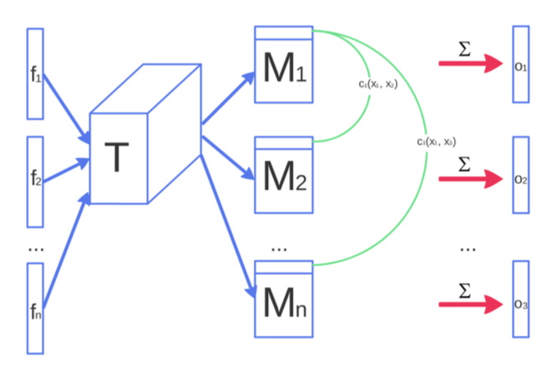
Minibatch Discrimination
Generator can collapse to a parameter setting where it always emits the same point. When collapse to a single mode is imminent, the gradient of the discriminator may point in similar directions for many similar points.
After collapse has occurred, the discriminator learns that this single point comes from the generator, but gradient descent is unable to separate the identical outputs.
An obvious strategy to avoid this type of failure is to allow the discriminator to look at multiple data examples in combination, and perform minibatch discrimination.
The concept of minibatch discrimination is quite general: any discriminator model that looks at multiple examples in combination, rather than in isolation, could potentially help avoid collapse of the generator.
Features f from sample x are multiplied by tensor T and cross-sample distance is computed

Slide 28
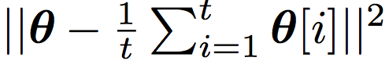
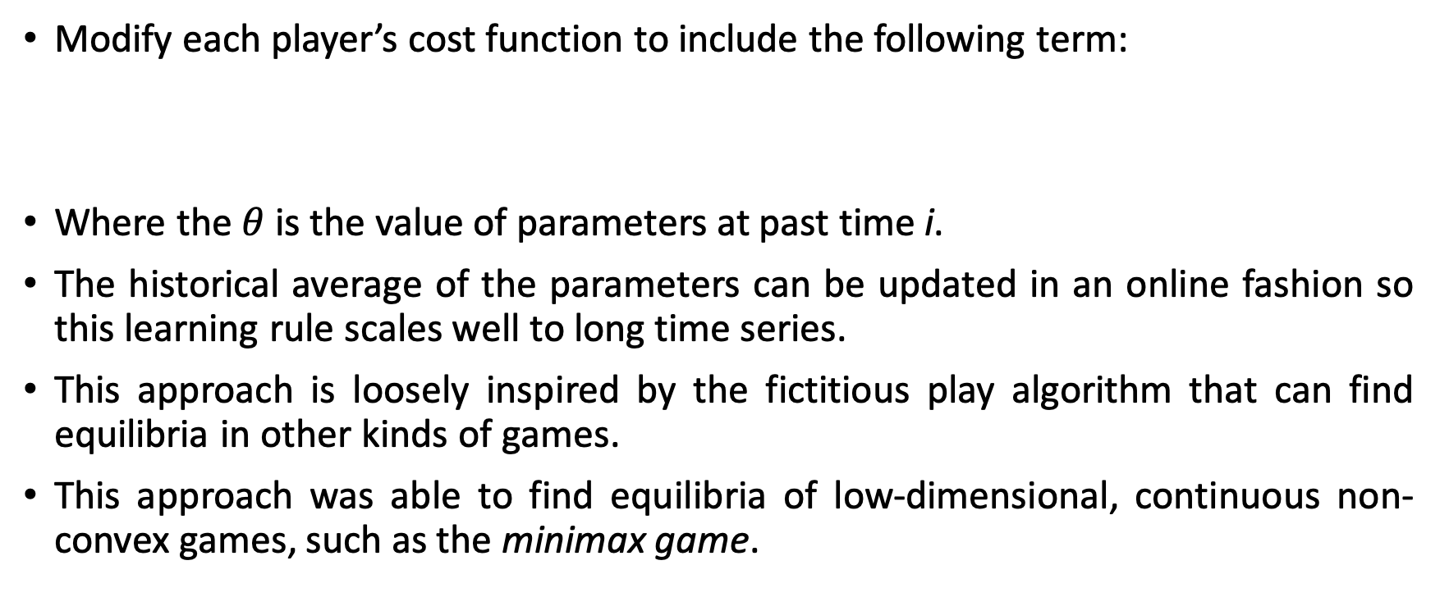
Historical Averaging
Modify each player’s cost function to include the following term:
Where the $θ$ is the value of parameters at past time i.
The historical average of the parameters can be updated in an online fashion so this learning rule scales well to long time series.
This approach is loosely inspired by the fictitious play algorithm that can find equilibria in other kinds of games.
This approach was able to find equilibria of low-dimensional, continuous non-convex games, such as the minimax game.

Slide 29
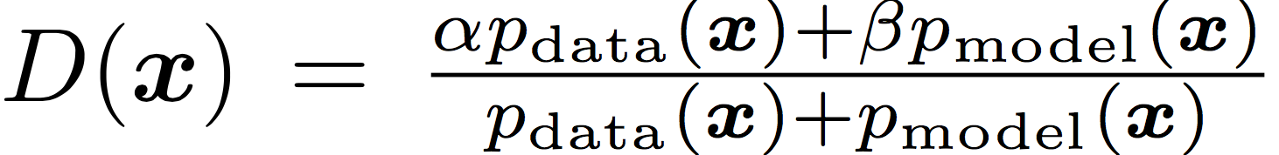
One Sided Label Smoothing
Label smoothing, a technique from the 1980s recently independently re-discovered by Szegedy et. al, replaces the 0 and 1 targets for a classifier with smoothed values, like .9 or .1, and was recently shown to reduce the vulnerability of neural networks to adversarial examples.
Replacing positive classification targets with α and negative targets with β, the optimal discriminator becomes:
The presence of p_{model} in the numerator is problematic because, in areas where p_{data} is approximately zero and p_{model} is large, erroneous samples from p_{model} have no incentive to move nearer to the data. We therefore smooth only the positive labels to α, leaving negative labels set to 0.

Slide 30
Virtual Batch Normalization
Batch normalization greatly improves optimization of neural networks, and was shown to be highly effective for DCGANs. However, it causes the output of a neural network for an input example x to be highly dependent on several other inputs x′ in the same minibatch.
To avoid this problem Salimans et al. introduce virtual batch normalization (VBN), in which each example x is normalized based on the statistics collected on a reference batch of examples that are chosen once and fixed at the start of training, and on x itself.
The reference batch is normalized using only its own statistics. VBN is computationally expensive because it requires running forward propagation on two minibatches of data, so it is recommended to use it only in the generator network.

Slide 31
Outline
Introduction to Generative Models
Generative Adversarial Networks (GANs)
Improved GAN Techniques
Deep Convolutional GAN (DCGAN)
Conditional GAN (CGAN)

Slide 32
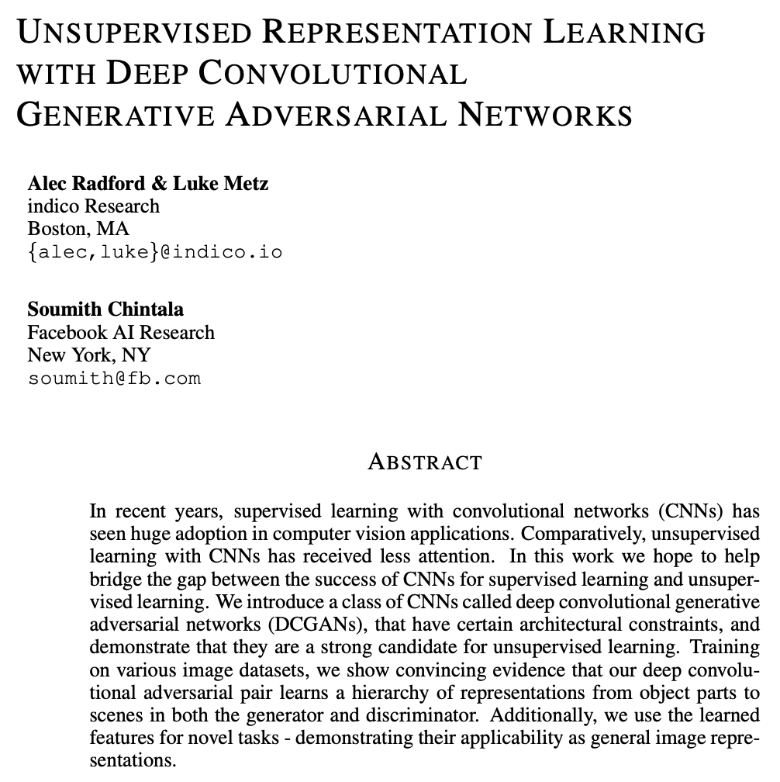
Deep Convolutional GANs
A convolutional neural network (CNN) is neural architecture that performs well for visual image analysis. The hidden layers of a CNN typically consist of a series of convolutional layers that convolve with a multiplication or other dot product. The activation function is commonly ReLU or LeakyReLU, and is subsequently followed by additional convolutions such as pooling layers, fully connected layers and normalization layers.
DCGAN Architecture (Radford, et.al, @ ICLR 2016 )
Replace any pooling layers with strided convolutions in D and fractional-strided convolutions in G.
Use batch normalization in both G and D
Remove fully connected hidden layers for deeper architectures.
Use ReLU activation in generator for all layers except for the output, which uses Tanh.
Use LeakyReLU activation in the discriminator for all layers.

Slide 33
DCGAN Approach
Generating Natural Images
Generative image models: parametric and non- parametric.
The non-parametric models often do matching from a database of existing images, often matching patches of images ex. texture synthesis, super-resolution and in-painting.
Parametric models has been explored extensively , had not much success till now.
DCGAN Approach
Replace any pooling layers with strided convolutions (discriminator) and fractional-strided convolutions (generator).
Use batch normalization in both G and D
Remove fully connected hidden layers for deeper architectures.
Use ReLU activation in generator for all layers except for the output, which uses Tanh.
Use LeakyReLU activation in the discriminator for all layers.

Slide 34
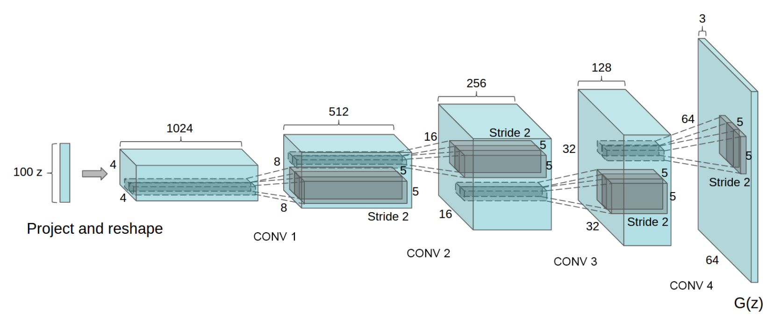
DCGAN Architecture
DCGAN generator used for LSUN scene modeling. A 100 dimensional uniform distribution Z is projected to a small spatial extent convolutional representation with many feature maps. A series of four fractionally-strided convolutions (in some recent papers, these are wrongly called deconvolutions) then convert this high level representation into a 64 ⇥ 64 pixel image. Notably, no fully connected or pooling layers are used.

Slide 35
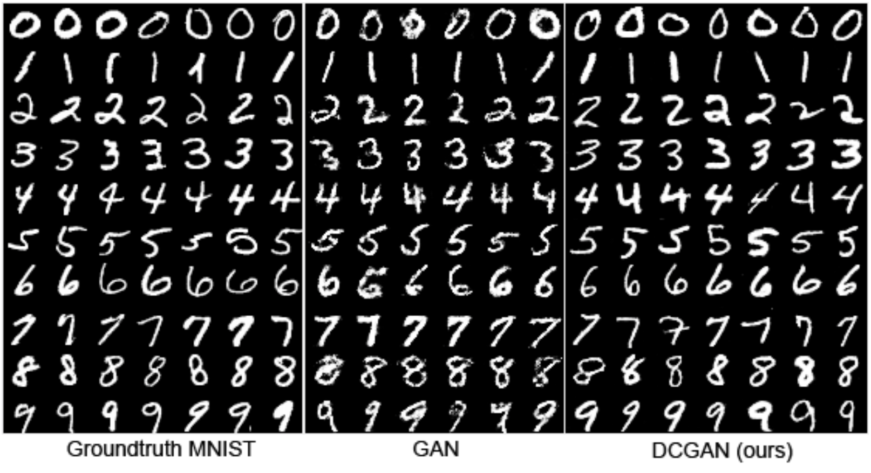
DCGAN Results – MNIST Dataset
Side-by-side illustration of (from left-to-right) the MNIST dataset, generations from a baseline GAN, and generations from our DCGAN

Slide 36
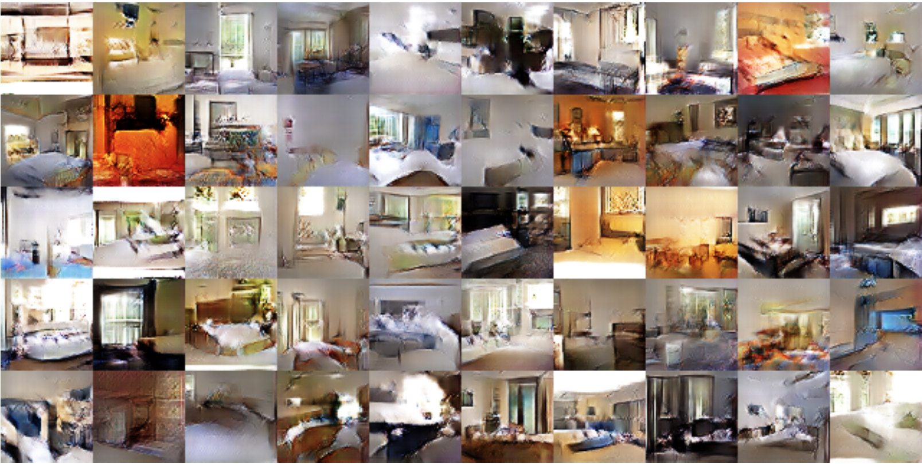
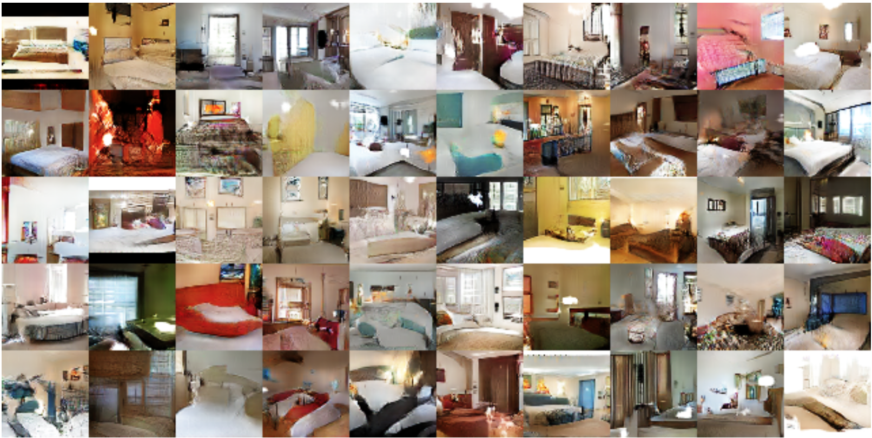
DCGAN Results – LSUN Bedrooms Dataset
Generatedbedroomsafteronetrainingpassthroughthedataset.Theoretically, the model could learn to memorize training examples, but this is experimentally unlikely as we train with a small learning rate and minibatch SGD. We are aware of no prior empirical evidence demonstrating memorization with SGD and a small learning rate.
Generatedbedroomsafterfiveepochsoftraining.Thereappearstobeevidenceofvisual under-fitting via repeated noise textures across multiple samples such as the base boards of some of the beds.

Slide 37
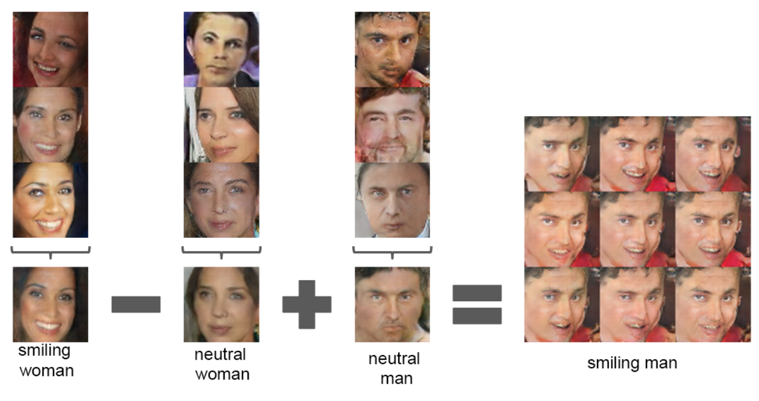
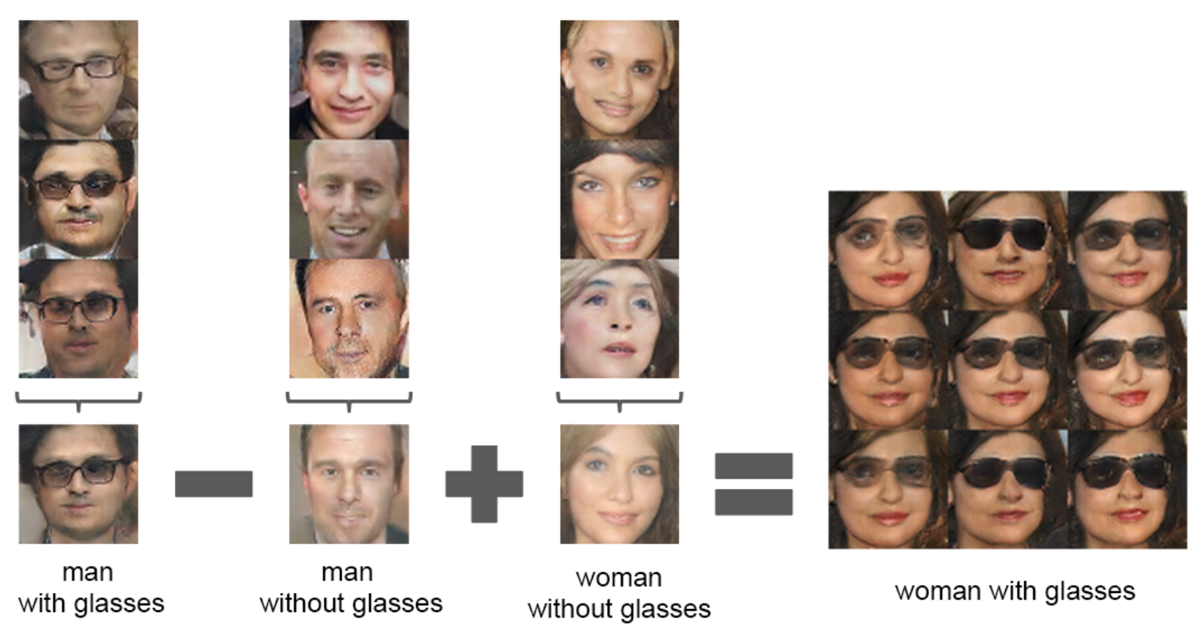
Results – Vector Arithmetic
Vector arithmetic for visual concepts. For each column, the Z vectors of samples are averaged. Arithmetic was then performed on the mean vectors creating a new vector Y . The center sample on the right hand side is produce by feeding Y as input to the generator. To demonstrate the interpolation capabilities of the generator, uniform noise sampled with scale +-0.25 was added to Y to produce the 8 other samples. Applying arithmetic in the input space (bottom two examples) results in noisy overlap due to misalignment.

Slide 38
Outline
Introduction to Generative Models
Generative Adversarial Networks (GANs)
Improved GAN Techniques
Deep Convolutional GANs
Conditional GANs

Slide 39
Why Conditional Generation is Important?
Key Issues:
It is challenging to scale deep neural networks to accommodate an extremely large number of predicted output categories.
Much of the work to date has focused on learning one-to-one mappings from input to output. However, many interesting problems are more naturally thought of as a probabilistic one-to-many mapping.
Proposed Solutions:
One way to help address the first issue is to leverage additional information from other modalities : for instance, by using natural language corpora to learn a vector representation for labels in which geometric relations are semantically meaningful.
One way to address the second problem is to use “a conditional probabilistic generative model”, the input is taken to be the conditioning variable and the one-to-many mapping is instantiated as a conditional predictive distribution.

Slide 40
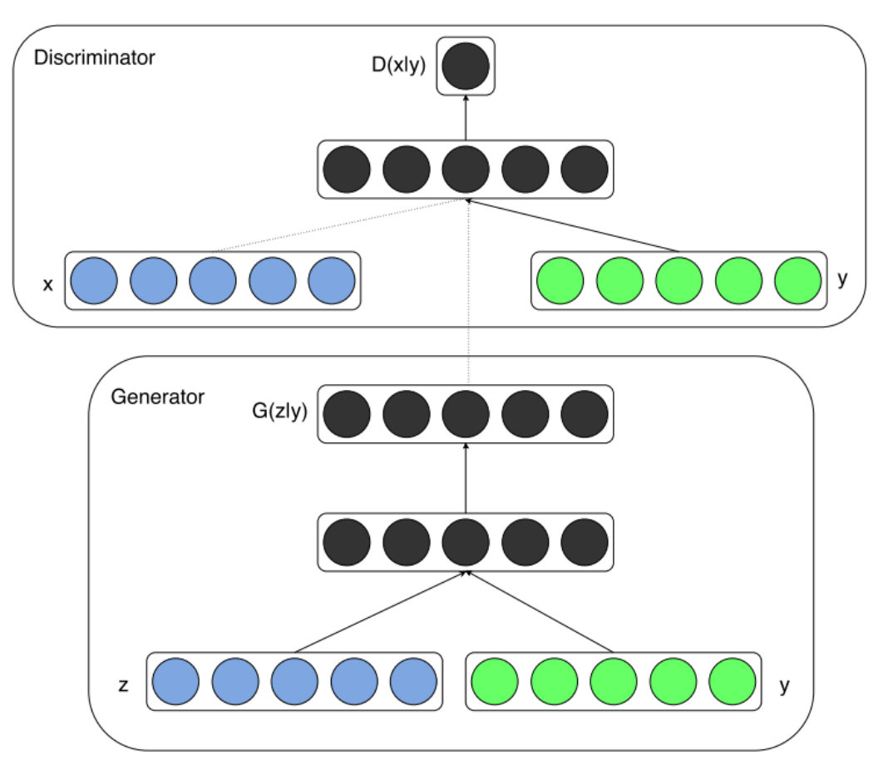
CGAN Introduction
Generative adversarial nets can be extended to a conditional model if both the generator G and discriminator D are conditioned on some extra information y. In this case y could be any kind of auxiliary information, such as class labels or data from other modalities. We can perform the conditioning by feeding y into the both the discriminator and generator as additional input layer.
In the generator the prior input noise p_{z}(z), and y are combined in joint hidden representation, and the adversarial training framework allows for considerable flexibility in how this hidden representation is composed.
MinMax Objective Function for CGAN:

Slide 41


Conditional GAN Architecture
Basic CGAN for Convolutional

Slide 42

CGAN Results
An extended CGAN model on the face image dataset, now using both the image data x and the face attribute data y.
In the experiments, particular subset of the original face attributes being used and attributes which do not have clear visual effects in the cropped images in our dataset were eliminated.
In each row we begin with a conditional data value y sampled from the empirical distribution p_{y}. In each column we apply random shifts to that value y, and sample an output image. The shifts cause noticeable differences in facial features, though it is evident that the slightly shifted values of y still lead to similar-looking faces.
The outlined face images at the far right show the nearest neighbor in the training data to the sampled image in the second-to-last column; this demonstrates that the generator has not learned to simply overfit the training data.

Slide 43

CGAN Results
Results of constant additive shifts along particular axes of the conditional data y.
REF: Jon Gauthier, Conditional generative adversarial nets for convolutional face generation

Slide 44
What You Will Learn Next Week

Slide 45
Known Problems in GANs
Training MM-GANs requires finding Nash equilibrium of a non-convex game with continuous, high dimensional parameters. A Nash equilibrium is a point such that cost functions of D and G are both at minimum. Finding Nash equilibrium is a hard research problem.
Algorithms exist for specialized cases, but hard to apply to the GANs cases, where the cost functions are non-convex, the parameters are continuous, and the parameter space is extremely high-dimensional.
Gradient descent techniques are designed to find low value of cost function, rather than to find the Nash equilibrium of minimax game. When used to seek Nash equilibrium Gradient descent is showing instability issue and may fail to converge.
Well known non-convergence issues in GANs are:
Vanishing Gradient
Mode Collapse
One way to overcome this is to use
better divergence formulation of GANs

Slide 46


GAN Divergence Formulation
Have: Two collections of samples X; Y from unknown distributions P and Q.
Goal: Learn distinguishing features that indicate how P and Q differ.
Divergences

Slide 47

Types of Divergences
GANs offer much more flexibility in the definition of distance or divergence.
Each type of divergence gives different behaviour of convergence.

Slide 48
HOME WORK WEEK 1

Slide 49




Preparing Dataset & Train Your GANs
Public Dataset (MNIST, COCO, CelebA, ImageNet)
DSC-UI-SRIN Github: https://github.com/DSC-UI-SRIN
Train your NS-GANs at Collab
Paper Reading

Slide 50

Goodfellow et.al., @ NIPS 2014.
Introduced GAN initial formulation as two-player minmax game:
Initial theoretical analysis:
Global Optimality $p_{g}=p_{data}$
Train $G$ to maximize $\log\left(D\left(G\left(z\right)\right)\right)$produce better gradients instead of minimize $log⁡(1−D\left(G\left(z\right)\right))$
Simultaneous gradient descent converges if the updates are made in function (not parameter) space
Convergence of SGD only if $G$ and $D$ have enough capacity. Minimizing JSD to reach Nash Equilibrium.
Known problems:
The Helvetica scenario or mode collapse
Too many values of latent variable $z$generate same value of $x$.
Notes:
Reference:
Goodfellow, I. J., Pouget-Abadie, J., Mirza, M., Xu, B., Warde-Farley, D., Ozair, S., Courville, A., and Bengio, Y. (2014b). Generative Adversarial Networks. In NIPS’2014.

Slide 51

Ian Goodfellow, @ ICLR 2015.
Review of GAN and NCE (Noise-Contrastive Estimation) concepts for generative model and MLE
Both are primarily driven by a function we call distinguishability game value function:
MLE, NCE, and GANs are all asymptotically consistent, both have stationary points by minimizing a convex divergence in function space. For MLE and NCE, this stationary point is a global maximum of their objective function. For GANs it corresponds to a saddle point, a local maximum for $D$ and a local minimum $G$.
Key Insights for GAN:
GAN cannot implement MLE as it learns in the generator. A modified version of NCE related to MLE.
The existing theoretical work on GANs does not guarantee convergence in non-convex case.
Problem of non-convergence of independent SGD in the non-convex case may explain the underfitting observed in GANs and suggests the application of better algorithms for solving for the equilibrium strategies of the distinguishability game. Or how to find Nash Equilibrium in high dimension, continuous and non-convex games.
Notes:
Reference:
Goodfellow, I. J. (2014). On distinguishability criteria for estimating generative models. In International Conference on Learning Representations, Workshops Track .

Slide 52



Ian Goodfellow, @ NIPS 2016.
More detail tutorial on GAN initial concept. Minimizing the KL divergence between $p_{data}$ and $p_{model}$ is exactly equivalent to maximizing the log-likelihood (MLE) of the training set. Solution of GAN’s minimax (zero-sum) game is Nash Equilibrium.
Heuristic/Non-Saturating Game
Minimax: $G$ maximizes while $D$ minimizes cross-entropy so $G$ gradient vanishes/saturates!
Heuristic: Use cross-entropy minimization for $G$ to maximize $D$ being mistaken.
MLE cost – GAN using KL Divergence
Mode collapse is driven by a factor other than choice of divergence.
Top Problems in GAN:
Non-Convergence
Mode Collapse
Finding Nash Equilibrium
Quantitative Evaluation
Variance reduction techniques could be an important research area for improving the performance of GANs, especially GANs based on MLE.

